Slide 1
AirSwift
Sky is not the limit
FINANACE DEPARTMENT
Team:- MERCURY

Slide 2
MAIN OBJECTIVES
1. To achieve Break-Even within first year of operations.
2. Dividing the Budget for whole division for Financial Year 2021-2022 is Rs. 10 Crore

Slide 3
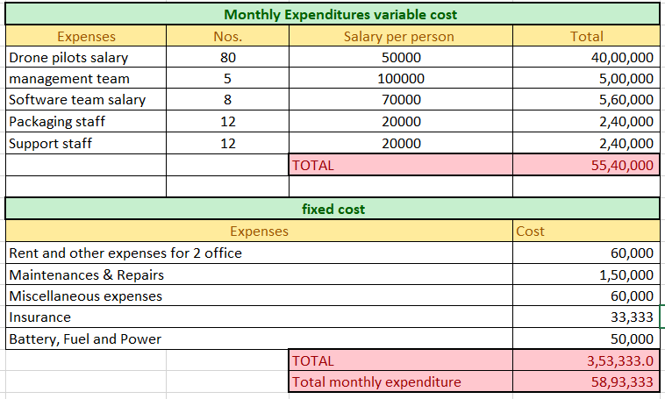
MONTHLY EXPENDITURES

Slide 4
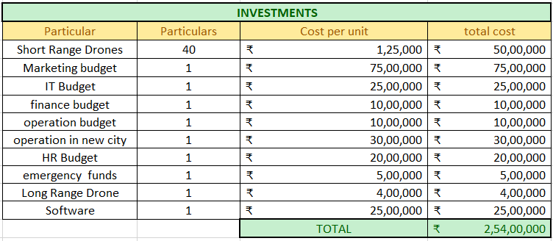
INVESTMENT AND BUDGET ALLOCATED

Slide 5
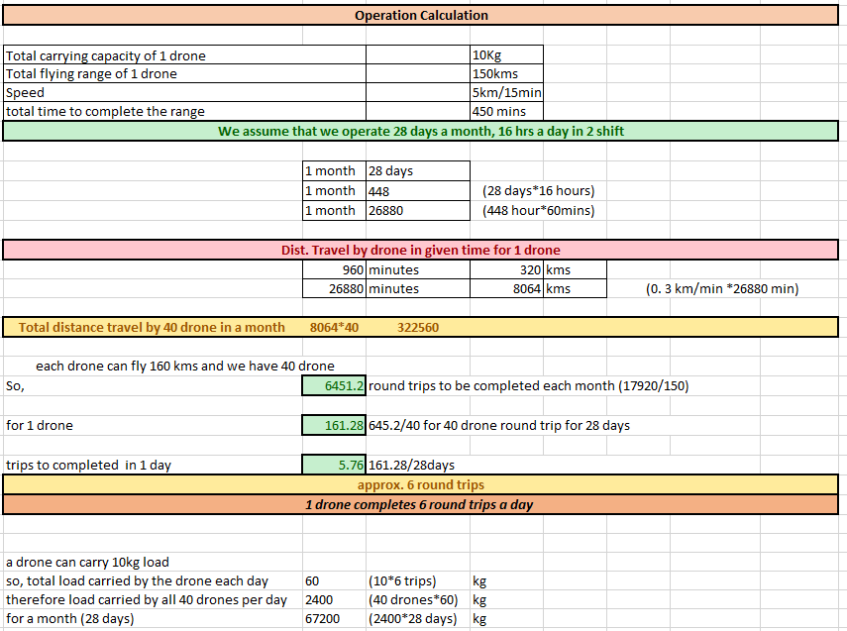
OPERATION CALCULATION

Slide 6
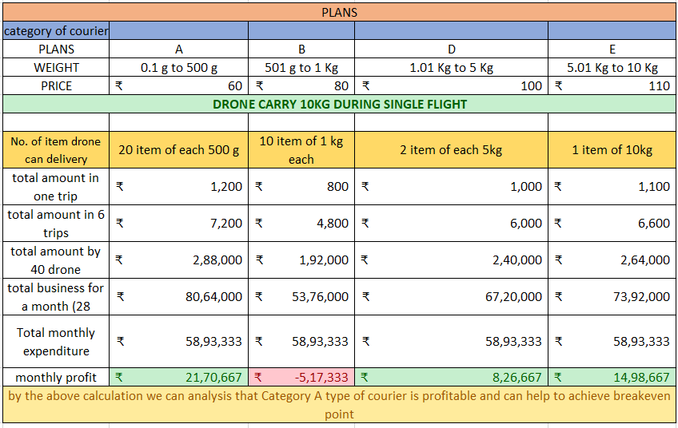
PLANS

Slide 7
PROJECTION AND CONCLUSION

Slide 8
THANK YOU

